Slide 1
Example 1: A Sensitive Survey Question
- A firm wants to know how many employees use illegal drugs.
- The survey is randomized so respondents can be honest.
Respondents Flip a Coin:
If H, see Q1: “Do you carpool to work?”
If T, see Q2: “Have you used illegal drugs within the last month?”
Your answer:
Yes
No
The firm cannot distinguish whether you were answering Q1 or Q2.
What we know:
8000 employees; all use a fair coin; all answer honestly.
1420 answer “Yes” (either to Q1 or Q2)
35% of employees carpool to work
Notes:
A firm is considering a drug-testing program for its employees

Slide 2
Example 1: A Sensitive Survey Question
What we know:
8000 employees; all use a fair coin; all answer honestly.
P(Q1) = P(Q2) = 1 / 2
1420 answer “Yes” (either to Q1 or Q2)
P(Yes) = 1420 / 8000 = 0.1775
35% of employees carpool to work
P(Yes | Q1) = 0.35
Q. How many employees answered “Yes” to Q2?
P(Yes | Q2) = ?
Notes:
A firm is considering a drug-testing program for its employees

Slide 3
Example 2: Die Rolls
Q. Set up the complete probability grid.
E : Even : {2, 4, 6}
O : Odd : {1, 3, 5}
L : Low : {1, 2, 3}
H : High : {4, 5, 6}
Notes:
A firm is considering a drug-testing program for its employees

Slide 4
Example 3: Walmart Adds on Facebook
- Walmart collected data on ads displayed on Facebook.
P(Click) = 0.2
P(Young) = 0.34
P(Female and NotYoung) = 0.4
P(Young and NoClick) = 0.3366
P(NotFemale and NotYoung and NoClick) = 0.2587
Q. What’s the probability an ad targeted at women above 24 will click?
P(Click | Female and NotYoung) = ?
Notes:
A firm is considering a drug-testing program for its employees

Slide 5
Example 4: Reaching the World Cup Final
- ENG played AUS and ESP played SWE.
P(ENG beats AUS) = 0.57
P(ESP beats SWE) = 0.6
Q. Set up the complete probability grid.
Notes:
A firm is considering a drug-testing program for its employees

Slide 6
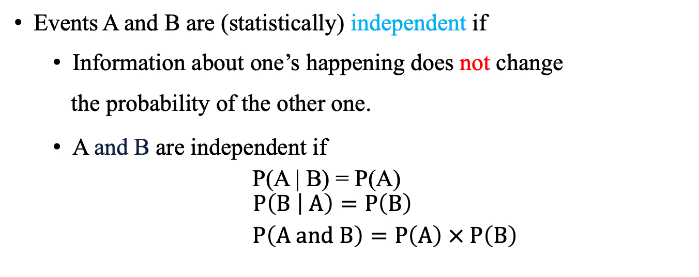
Independence
Events A and B are (statistically) independent if
Information about one’s happening does not change
the probability of the other one.
A and B are independent if
P(A | B) = P(A)
$$P\left(B | A\right)=P\left(B\right)$$
$P\left(A and B\right)=P\left(A\right) × P\left(B\right)$
Notes:
It is not that they have nothing to do with each other. It is just that you do not revise the probability. An event does not care about which part of the event that occurs.
| 1 | 2 |.3 |
| 4 | 5 |.6|
A and B are independent if any of the following holds true:
If any of the above equalities is true, then all three are true (can you show this with math?)

Slide 7
Example 5: Morning Tea
Q. Taylor always drinks tea after arriving at Posvar Hall in the morning, while Katherine and Jane sometimes join him. The probability that Katherine drinks tea with Taylor is ¼ and the probability that Jane drinks tea with Taylor is 3/8. The probability that Taylor drinks tea by himself is 1/2.
a. What is the probability that Taylor has tea with Jane while Katherine is not there?
b. If Katherine did not have tea with Taylor, what is the probability that Jane was not there either?
c. If Taylor had tea with Jane this morning, what is the probability that Katherine did not join them?
Notes:
A firm is considering a drug-testing program for its employees

Slide 8
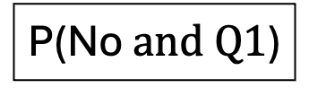
Example: A Sensitive Survey Question
Q. How many employees answered “Yes” to Q2? P(Yes | Q2) = …
Yes
P(Yes and Q1)
P(Yes | Q1) = 0.35
Q1
P(Q1) = 0.5
No
P(Y) = 0.1775
P(No $and Q1$)
Yes
P(Yes and Q2)
P(Yes | Q2) = ?
Q2
P(Q2) = 0.5
No
P(No and Q2)
Notes:
A firm is considering a drug-testing program for its employees

